Slide 1
DESIGN OF BIDIRECTIONAL BUS BASED ON VERILOG HDL
20881A04C8:BHAVANA
20881A04F8:ASWITHA
Under the guidance of:
Dr.S RAJENDAR
Silde no:1

Slide 2
CONTENT:
INTRODUCTION
OBJECTIVE
DESCRIPTION
IMPLEMENTATION
RESULTS
CONCLUSION
REFRENCES
Silde no:2

Slide 3
INTRODUCTION:
It is a data bus that flows the data in both direction from microprocessor to memory
A bi-directional bus can carry binary information in either direction
Sets of wires with single information
A bidirectional bus buffer is a type of logic circuit whose input and output pins can be configured as input and output to receive and transmit data
Silde no:3

Slide 4
OBJECTIVE:
Using Verilog HDL to design bidirectional ports can reduce the number of ports designed, improve resource utilization and reduce hardware overhead.
Silde No:4

Slide 5
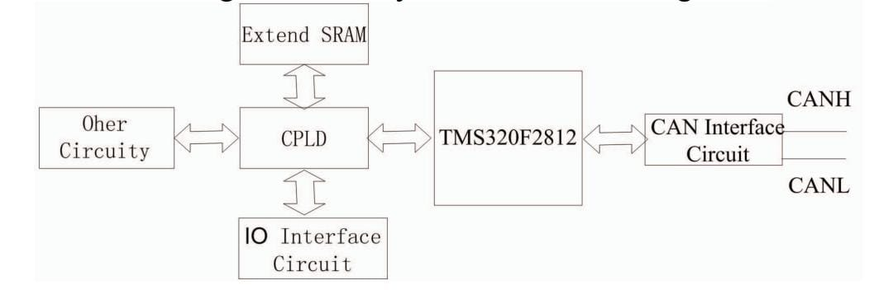
DESCRIPTION:
The module is composed of DSP, off-chip SRAM, programmable logic CPLD, CAN bus interface.
Input and output interface circuit, etc. CPLD is the bridge between DSP and peripheral circuit.
According to the needs of the system, CPLD integrates all kinds of control signals of the DSP and outputs corresponding control signals to control the peripheral circuits.
The system communicates with the host computer and other control modules through CAN bus.
The module collects all kinds of state information through the input and output interface circuit.
Silde no:5

Slide 6
CODE:
E code instantiation statement is as follows
module inout_test; reg xrd,xwe; wire datain[2:0], dataout[2:0]; inout inout (xrd,xwe, datain,dataout);
nitila begin datain = 3’011; dataout=3’zzz; xrd =1’1; xwe =1’10 #100 xwe =1’0; xrd=1’1; datain = 3’010; #100 xwe =1’1; xrd=1’0; dataout = 3’000; end
Endmodule

Slide 7
CONCLUSIONS:
This paper introduces the design method ofbidirectional bus based on Verilog HDL through acomprehensive example in the design of logic controlcircuit of a certain artillery. Combining with the actual guncontrol, the design example is simulated, and thecorrectness of the design is verified. This design has beenapplied in the design of a certain type of artillery controlsystem. The bidirectional bus design based on HardwareDescription Language introduced in this paper can also beapplied to other integrated circuit design schemes

Slide 8
REFERENCES:
XIA Yu-wen,Digital System Design Tutorial Beijing University of Aeronautics and Astronautics Press ,2008. (in Chinese)
[2] QIAN Honglin, Design of Digital Clock Based on QuartusII of EDASoftware Mechanical Management and Development 2017 No.12109-115. (in Chinese)

